Slide 1



AUTOMATED BUSINESS SOLUTION
With QR code Integration
Presented by:
Md Soykot Ahamed(22235103247)
Md. Sadat Islam(22235103269)
Utsob(22235103256)
Md Jobayer Hossan(22235103236)
Ali Akbar Rakib(22235103236)

Slide 2

OVERVIEW
OBJECTIVES
PROBLEM STATEMENT
PROBLEM SOLUTION
MARKET ANALYSIS
STARTUP AND BUSINESS MODEL
EXPENSE AND REVENUE
OUR RELATED WORK SAMPLE

Slide 3

Our Objectives
01
Automate Business Operations:
Streamline business processes by integrating QR code technology with data management systems to reduce manual tasks and improve efficiency.
Enhance Data Management
Provide seamless integration between MySQL databases and Google Sheets to ensure real-time data synchronization and accessibility
02
Facilitate Advanced Analytics
Implement analysis tools to provide insights into customer spending patterns and product sales trends using visual representations
03
Improve Product Tracking
Utilize QR codes for better product tracking and management, enabling easy access to product details and expiration monitoring
04
Enable Secure and Efficient Customer Management
Incorporate facial recognition technology to ensure secure customer identification and streamline customer-related processes
05

Slide 4





PROBLEM STATEMENT
02
Target Business: FACEBOOK Business,Small Business(Rural and Non Rural),Super Shop
01
small businesses, rural enterprises, and urban shops. Many of these businesses lack access to affordable and effective tools for streamlining their processes, such as managing inventory, tracking customer interactions, analyzing sales trends, and ensuring data accuracy.
Facebook businesses often struggle with manual tasks like recording product details in Excel sheets, managing deliveries, and tracking inventory.And in Customer side
Verifying product authenticity
03
Super shops often struggle to provide personalized services to VIP customers due to manual handling of preferences and purchase histories. This can result in delays, lack of tailored offers, and missed opportunities to enhance customer loyalty.

Slide 5
PROBLEM SOLUTION
OCR Image Extraction: Use Optical Character Recognition to automate data extraction from images.
Machine Learning Algorithms: Apply ML models for efficient data analysis tailored to business needs.
Google Sheets and MySQL Integration: Synchronize data in real-time for better workflow management.
Customer Sales Analysis: Offer advanced analytics on sales trends and customer behavior for informed decision-making.

Slide 6





MARKET ANALYSIS
Below is a snapshot of the total users in each domain, both nationally and globally
Small to Medium Buseness
Super Shop
Facebook Business
National: 400
National: 3 million
National: 7.8 million
Worldwide:Over 2 million
Worldwide:Over 200 million
Worldwide:Over 400 million

Slide 7








Basic Plan
Premium Plan
Subscription-Based SaaS Model
Freemium Model with Upsells
Free Tier
Paid Add-ons
STARTUP AND BUSINESS MODEL
Transaction-Based Commission
Identify and Target Niche Markets
Offer Affordable, Scalable Pricing Models

Slide 8









EXPENSE
REVENUE
Development Costs:
Small Business: 100 customers x $40 = $4,000/month.
Estimated Cost: $20,000–$50,000.
Maintenance
Facebook Business: 100 customers x $70 = $7,000/month.
Annual: $15,000–$30,000
Break-even Analysis:
Initial Setup Costs: $60,000–$100,000.
Revenue: $250,000+ in the first year.
Break-even: 6–12 months.
Technology Costs
Monthly: $500–$1,000.
Supermarkets: 50 customers x $150 = $7,500/month
Marketing and Sales Costs
Monthly: $1,000–$5,000
Total Monthly Revenue: $18,500/month or $222,000/year

Slide 9
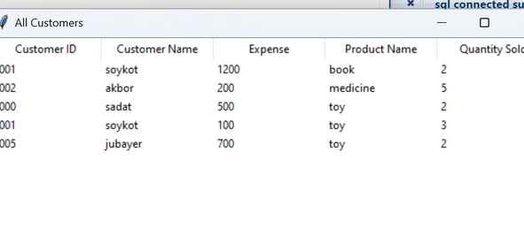
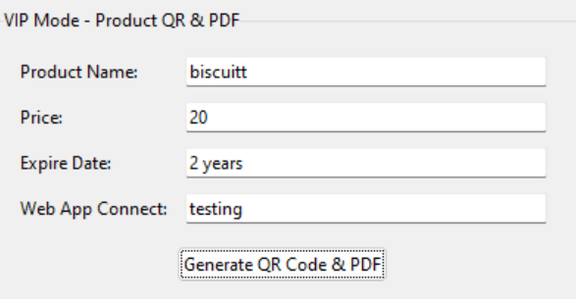
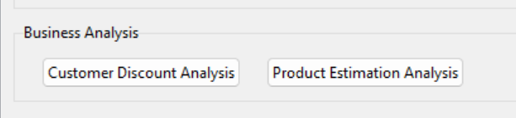
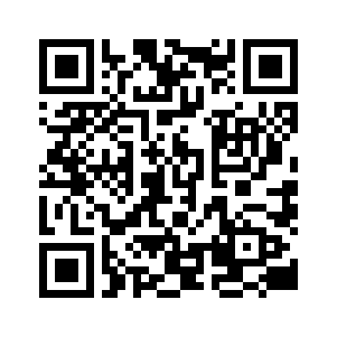
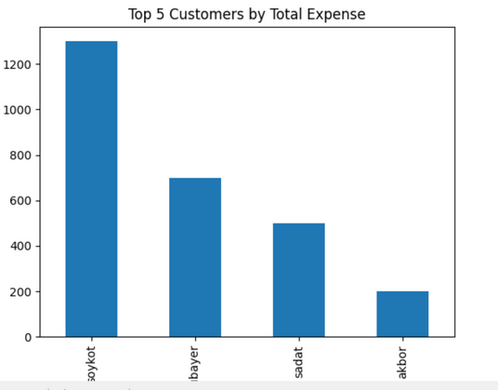
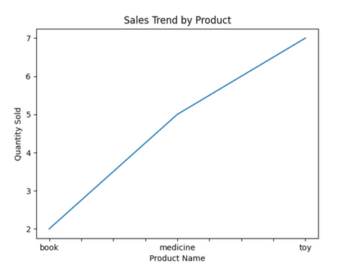

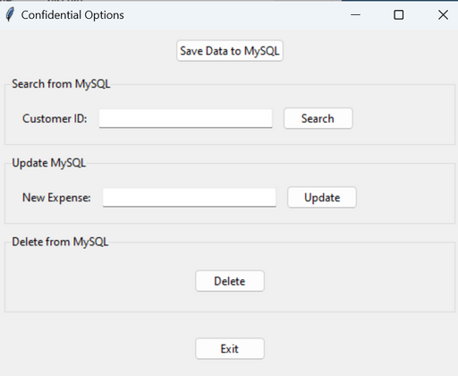
synchronization Data Realtime
Product Varification And Vip Customer Handle
Our Related Work
Market analysis Realtime
SQL PART

Slide 10
OCR models and machine learning algorithms for accurate data extraction and customer sales analysis
Under Construction

Slide 11
QnA

Slide 12


THANK YOU

